Slide 1
Applied Physics NS (101)
LECTURE # 10
DATE: 12TH SEPTEMBER , 2019

Slide 2
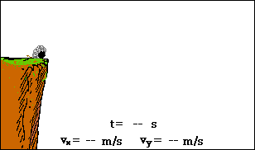
Final Horizontal and Vertical component of velocity: vxf = v Cosθ vyf = v Sinθ -gt
The projectile motion is the superposition of two motions:
constant velocity motion in the horizontal direction and
free-fall motion in the vertical direction.

Slide 3

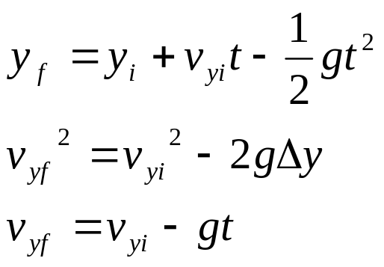
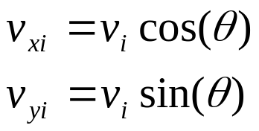
Equations
X- Component
Y- Component
Vectors
Note: g= 9.8 m/s^2

Slide 4

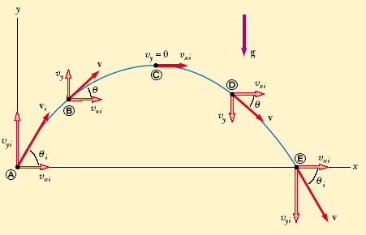





PROJECTILE MOTION
the path of a projectile, which we call its trajectory, is always a parabola

Slide 5
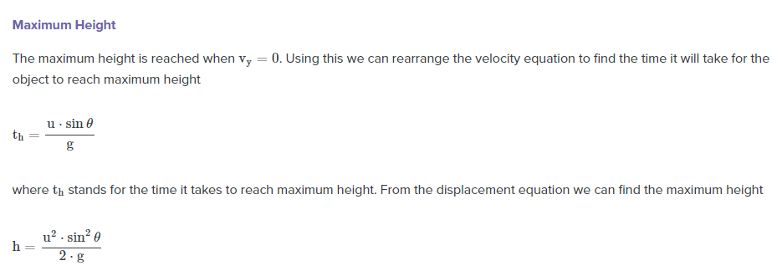

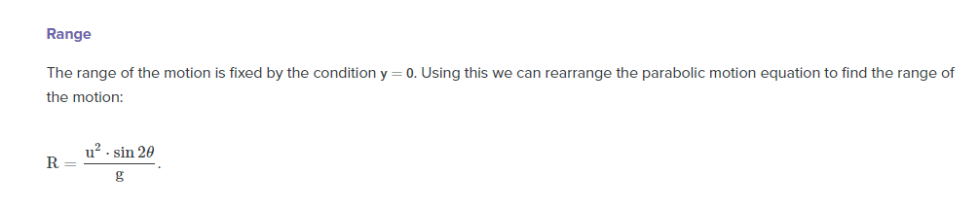

Slide 6
A particle moves in the xy plane with an x component of acceleration only, given by a_{x} = 4 m/s² . The particle starts from the origin at t =0 with an initial velocity having an x component of 20 m/s and a y component of -15 m/s. (a)Determine the components of velocity vector as a function of time and total velocity vector at any time .(b)Calculate the velocity and speed of the particle at t=5sec. (c) Determine the x and y coordinates at any time t and the displacement vector at this time.

Slide 7
A long –jumper leaves the ground at an angle of 20⁰ to the horizontal and the a speed of 11 m/s. How far does he jump and what is the maximum height reached?

Slide 8
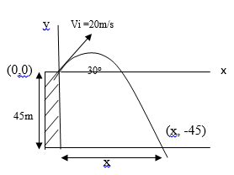
A stone is thrown from the top of a building upward at an angle of 30⁰ to the horizontal and with an initial speed of 20m/s , as in figure-1 . If the height of the building is 45 m. (a) How long is the stone “in flight” (b) What is the speed of the stone just before it strikes the ground?

Slide 9
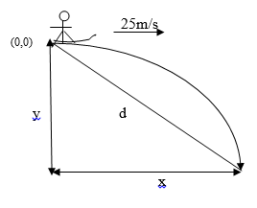
A ski jumper travel down a slope and leaves the ski track moving in the horizontal direction with a speed of 25m/s as in figure-2. The landing incline below him falls off with a slope of 35⁰. Where does he land on the incline?

